Slide 1
Getting Involved in Volunteering
Learning at Your Fingertips

Slide 2
In this module:
Overview
Why Get Involved?
7 Reasons to Volunteer
Getting Started
Working On Your Own
Working With Family
Getting Involved

Slide 3
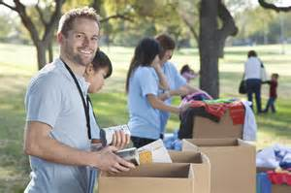
Overview
Whether you donate money or time, giving back is beneficial--and not just for the recipients. Research has shown that the old adage, “it’s better to give than to receive” is true after all.

Slide 4
Why Get Involved?
A Gallup survey on volunteering in the U.S.A. found that 52% of volunteers do it because they like doing something useful and helping others. Another 38% said they enjoy doing volunteer work and feeling good about themselves.

Slide 5
Why Get Involved?
Besides feeling good about yourself for doing something for others, giving back is also good for your physical health. In a Canadian study, 85% of Ontario volunteers rated their health as "good," compared to 79% of non-volunteers. Only 2% of volunteers reported "poor" health, one-third the amount of non-volunteers who reported the same health status.

Slide 6
Why Get Involved?
Still other studies have shown a relationship between volunteering and increased self-esteem, with volunteers reporting both greater personal empowerment and better health. Doing for others may stimulate the release of endorphins, which has been linked to improved nervous and immune system functions, too.

Slide 7
Why Get Involved?
Many people report a “high” from volunteering, similar to the good feelings that come from exercise. Others have found that volunteering can help fight depression. Helping others can help take your mind off your own problems and enable you to see the bigger picture. Once you see the difference you can make in another person's life, your own problems can seem smaller and more manageable.

Slide 8
Why Get Involved?
Many people report a “high” from volunteering, similar to the good feelings that come from exercise. Others have found that volunteering can help fight depression. Helping others can help take your mind off your own problems and enable you to see the bigger picture. Once you see the difference you can make in another person's life, your own problems can seem smaller and more manageable.

Slide 9
Why Get Involved?
Many people report a “high” from volunteering, similar to the good feelings that come from exercise. Others have found that volunteering can help fight depression. Helping others can help take your mind off your own problems and enable you to see the bigger picture. Once you see the difference you can make in another person's life, your own problems can seem smaller and more manageable.

Slide 10
7 Reasons to Volunteer
1. Develop new skills. Gaining skills, knowledge and expertise are common side effects of volunteering. Giving others your time brings you interesting and challenging opportunities that might not come along otherwise. This experience can be added to your resume and could result in a better paying job in the future.

Slide 11
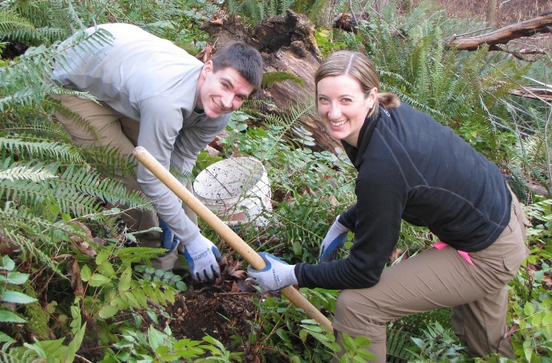
7 Reasons to Volunteer
2. Make social connections. Loneliness and boredom are common among retirees, students, and transplants to a new city. Volunteering can relieve this sense of social isolation and help you fill empty hours in the day.

Slide 12
7 Reasons to Volunteer
2. Make social connections. Loneliness and boredom are common among retirees, students, and transplants to a new city. Volunteering can relieve this sense of social isolation and help you fill empty hours in the day.

Slide 13
7 Reasons to Volunteer
3. Give back to your community. Doing something for the community you live in and returning the favor to those who have helped you are strong motivators. Everyone, rich or poor, takes from society, and volunteering is one way to show a sense of appreciation.

Slide 14
7 Reasons to Volunteer
4. Develop and grow as a person. Volunteering is an excellent way to explore your likes and dislikes. If you’re interested in a new career, volunteer in the field first to see if you will actually like it. You may find a totally unrelated field is a much better fit for you, one you’d never consider if you hadn’t volunteered there first.

Slide 15
7 Reasons to Volunteer
5. Gain a new perspective. Life can be hard and when you’re feeling down, your problems can seem insurmountable. Volunteering can offer a new perspective—seeing people who are worse off than you are, yet still hanging in there, can help you see your life in a whole new light.

Slide 16
7 Reasons to Volunteer
6. Know that you're needed. Feeling needed and appreciated are important, and you may not get that appreciation from your paid work or home life where the things you do are expected or taken for granted. When you volunteer, you realize just how much you are truly needed. Meeting people who need your help is a strong incentive to continue—people are depending on you. If you don’t do it, who will?

Slide 17
7 Reasons to Volunteer
7. Boost your self-esteem. Many volunteers experience a sense of increased self-esteem and greater self-worth. Helping others makes you feel good about yourself, because you’re doing something for someone that they couldn’t do for themselves.

Slide 18
Getting Started
Sometimes the most difficult question can be where to start. There are plenty of opportunities out there, and plenty of worthy causes that need help from someone just like you. Ask yourself a couple of questions:
What are you passionate about?
What are your interests?
What are your time constraints?

Slide 19
Getting Started
What are you passionate about?
Do you have a special connection to any organization? Maybe someone in your family suffers from a particular disease that you would like to support.
What community problem would you like to help solve?

Slide 20
Getting Started
What are your interests?
Is there a way that you tie in your interests, hobbies or profession to getting involved with the community? Volunteering does not have to boring or uninteresting to you.
Ex. You love carpentry. Why not work for habitat for humanity building a house.

Slide 21
Getting Started
What are your time constraints?
Sometimes, determining what you have time for may be a key piece. Find opportunities that work around your schedule.
Ex. If you work nights, volunteer at a school. If you work days, see if there i

Slide 22
Volunteering on Your Own
If you've never been involved in community service before, volunteering as an individual may be a good place to start. Want to improve your computer knowledge? You may get free on-the-job training.

Slide 23
Volunteering on Your Own
Have you been out of the workforce raising children? Volunteering may be a painless way for you to get back into the routine of working before taking the plunge into a paid position.

Slide 24
Volunteering on Your Own
And if you're looking for a career change, community service is a networker's dream. You can meet people who may offer opportunities you've never thought of. You can sample different workplaces and see how you like various fields. Your volunteering will definitely help others and may help you, too.

Slide 25
Volunteering With Family
Families can do many volunteer jobs. Even the smallest child (with adult supervision) can pick up garbage at the park, playground, or beach. You don't even have to be part of a big effort to do this. Get your family together, find some garbage bags, and head out.

Slide 26
Volunteering With Family
Or become involved in repair and renovation efforts for low-income residents. Younger kids might not be able to do the big jobs, but helping out by fetching a paintbrush or holding the nails involves them just the same.

Slide 27
Volunteering With Family
Work at a community food bank or soup kitchen as a family. Find an organization that serves the elderly. Take food to people who are homebound and visit with them. Your kids can brighten a lonely senior's day instantly

Slide 28
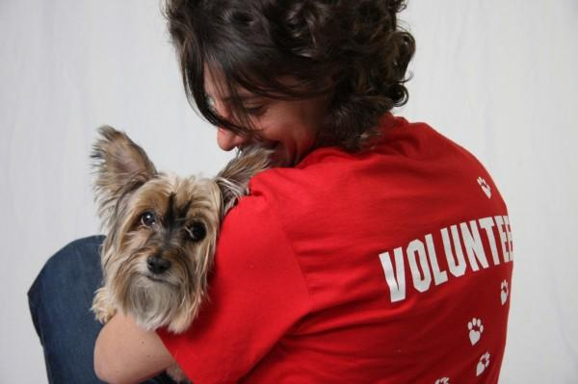
Volunteering With Family
Offer your family's help at the local animal shelter. Help plant flowers or trees. The possibilities are endless.

Slide 29
Getting Involved
The Internet offers lots of sites with information about volunteer opportunities. You can also call a favorite charity, hospital, or church directly to see if they have any needs, or just google "Volunteerism"

Slide 30
Getting Involved
Be prepared to answer questions such as:
What are your interests?
What are your skills?
Do you have any special needs?
Do you have a method of transportation?
How many hours a week do you have to volunteer?
Why do you want to volunteer?

Slide 31
Getting Involved
You'll probably be interviewed again once the clearinghouse matches you with an appropriate job. Some situations require more information. If you want to work with kids, for instance, you may have to undergo fingerprinting and a criminal background check.

Slide 32
Getting Involved
Be sure to be just as thorough when you question the organizations. Find out exactly what's expected of you before you accept the volunteer position. Be realistic and ask specific questions.

Slide 33
Getting Involved
When looking for a volunteer position, remember that it may be difficult to find the perfect volunteer slot. Be flexible, and keep looking if the agency you were referred to doesn't meet your needs. It may take a while to find a perfect fit, but once you do, it will be worth it.

Slide 34
Getting Involved
Once you do become involved, be responsible to those who depend on you. Be on time, dress appropriately, and let the volunteer coordinator know if you can't make it.

Slide 35
Summary
Whatever you choose to do, volunteering and community service can benefit both the community and your family. Get involved today!

