Slide 1
Giving Back to the Community
Learning at Your Fingertips

Slide 2
In this module:
Overview
10 Reasons to Give Back
Ways to Give Back
Giving Back at Work

Slide 3
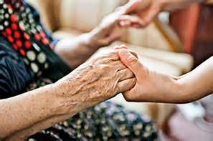
Overview
Here’s an important life lesson: no matter how tough you think your life is there’s always someone who has to face challenges that are even tougher than yours.

Slide 4
Overview
Giving to your favorite charity feels good, there's no denying that. But your charitable initiatives can have a greater impact on your company than you may think. Giving back to the community is the right thing to do for personal and business reasons.

Slide 5
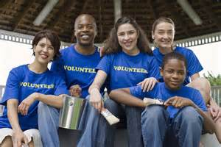
Overview
Gone are the days when donations are all about the tax break. Today entrepreneurs and executives are developing values-driven programs to help their philanthropic efforts grow even deeper roots.

Slide 6
10 Reasons to Give Back
Make an impact:
Looking to make a real, lasting difference in this world? Unlike other aspects of life you may not be able to control, volunteering allows you to choose where and how to make a difference. It’s easy to get inspired with a cause you truly care about—and it’s rewarding to see your direct impact.

Slide 7
10 Reasons to Give Back
Strengthen communities:
From cleaning up a street to reading to kids at the local library, you can enhance your own life by improving the areas where you work, live and play. A strong community with a high quality of life means safer, healthier lives for you and those around you.

Slide 8
10 Reasons to Give Back
Meet others:
Looking to broaden your network or find others with similar interests? Volunteering is a great outlet for meeting others. A local club or organization can put you face-to-face with the people right in your community—plus, it’s easy to bond over a shared passion. You can create lasting friendships with those you may not have otherwise met in your day-to-day grind.

Slide 9
10 Reasons to Give Back
Improve your health:
Yes! Volunteering is actually good for you. Studies have shown that volunteering makes people feel physically healthier, manage chronic health conditions and lower stress!

Slide 10
10 Reasons to Give Back
Take the lead:
Often what a great effort needs most is a great leader. If you see a cause that needs a push or a group that needs a head—take the lead! Many find leadership rewarding in itself because of the opportunity to share their passion, value and inspiration with others. When you take a leadership role, you also have the ability shape the world around you in the ways you choose.

Slide 11
10 Reasons to Give Back
Share expertise:
Everyone has a skill or experience from which someone else can benefit. If you aren’t putting your talents to their best use in your everyday life (or even if you are!), volunteering can be a prime way to share. Get out in your community and put your skills—from teaching to sewing—toward helping others. You may be surprised at how your own abilities sharpen when you share your knowledge.

Slide 12
10 Reasons to Give Back
Improve skills—or learn new ones:
Want to learn basic carpentry, improve your cooking or discover how something works? Classes and courses can come at a cost—but volunteering is free! Why not begin your learning at no charge with an organization or opportunity where you can learn by doing?

Slide 13
10 Reasons to Give Back
Up your resume ante:
Considering a career shift? Want to try out a new field before taking the leap? A volunteering gig can be a perfect way to fill a knowledge or employment gap. It can also be a valuable addition to a resume if you’re applying to a new job or graduate school program.

Slide 14
10 Reasons to Give Back
Find new opportunities:
Doors open when you volunteer. You can widen your social network, discover an organization in your community or finally talk to the person you always see on the bus! Who knows: You may even stumble across your dream job by meeting your future colleague or next job reference.

Slide 15
10 Reasons to Give Back
Because it just feels good:
Basic, but true. Doing the right things feel good.

Slide 16
Ways to Give Back
Donate clothing, furniture, and other possessions to those in need. (Side benefit: You will declutter your house/apartment.)
Set up a collection program at your office for money and non-perishables. (Make sure you thank everyone each time you write a check from the program to charity, or deliver the filled bucket to the local pantry.)
Ride in bike-a-thons, run or walk in 5Ks, or if you’re an ambitious athlete, participate in marathons and triathlons.

Slide 17
Ways to Give Back
Volunteer to help with bike-a-thons, 5Ks, etc. They always need volunteers the day of the event at registrations tables and more.
Volunteer at a soup kitchen/homeless shelter.
Teach English as a second language as a literacy volunteer, or as a first language to kids or grown-ups who need help.

Slide 18
Ways to Give Back
Tutor kids in math or any other subject.
And so much more—once again, check Google!

Slide 19
Giving Back At Work
Any small business, no matter how successful, can give back. All it takes is a dash of effort and a ounce of creativity.
And while getting a return on your “giving back" investment is not the goal, your business will definitely benefit from the exposure and goodwill generated by acts of kindness.

Slide 20
Giving Back At Work
Here are 6 tips to help you give back at work:
1. Donate what you can't use.
Businesses in almost every industry wind up with unused or obsolete (at least from a sales point of view) products and supplies.
And don't forget services, especially if your business is seasonal and you have unused capacity.

Slide 21
Giving Back At Work
1. Donate what you can't use.
What don't you use? How can you create value for someone else by re-purposing what you don't use?
People in need obviously benefit, but so do your employees, because they genuinely appreciate when you create the opportunity for them to make a difference.

Slide 22
Giving Back At Work
2. Teach.
The best way to make a long-term impact is to help people help themselves. You can teach an organization to maintain its own website, or handle its bookkeeping, or create more effective outreach materials... charities are often the ultimate in bootstrapping. Anything you can help a charity, or the people it serves, do more efficiently helps their dollars go farther.

Slide 23
Giving Back At Work
2. Teach.
Volunteer your time. Volunteer the time of your team as well, but only during work hours. Giving should be voluntary, not mandatory.

Slide 24
Giving Back At Work
3. Fundraise as a team.
You don't have to spend money from your own pocket. Most charities have online tools to help you fundraise through your friends and family.

Slide 25
Giving Back At Work
3. Fundraise as a team.
Easy links to facebook, twitter and Instagram make it even simpler. You can broadcast to your network. You would be surprised how many people respond. Then you combine your fundraising with your team members to really make a positive impact.

Slide 26
Giving Back At Work
3. Fundraise as a team.
The more specific the cause, the more likely people are to participate. You can participate in an established event or create your own. The more creative the better--and the more likely you will be to inspire others to give.

Slide 27
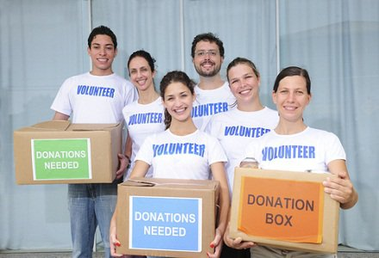
Giving Back At Work
3. Fundraise as a team.
Plus there's a side benefit: In the process you will create a sense of community and shared purpose within your team.

Slide 28
Giving Back At Work
4. Participate in a fundraising event.
Auctions are a popular way for organizations to raise money; often bidders will pay more than the value of the item as a way to help support the organization (especially since the amount of the bid that exceeds the fair market value of the item is tax-deductible.)

Slide 29
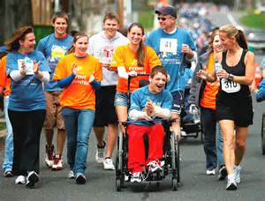
Giving Back At Work
4. Participate in a fundraising event.
And even though it's not the point, in the process you might gain a long-term customer.

Slide 30
Giving Back At Work
5. Create a win-win partnership.
Any business can build a partnership with specific products or services; the key is to make the tie-in as direct as possible. That way you not only raise money, you naturally help raise the organization's profile as well.

Slide 31
Giving Back At Work
5. Create a win-win partnership.
And you give your customers an easy way to make a difference; that's something customers genuinely appreciate.

Slide 32
Giving Back At Work
6. Use your platform as a business leader to draw attention to a cause.
Almost every organization hopes to create ties to local business owners and community leaders.
Offer testimonials. Offer to speak at an event and share why you feel the cause is important. Offer to serve as a contact or source for local media seeking quotes or background information. If you aren't sure how to help, just call your favorite organization and say, "How can I help you spread the word about the great things you do?"

Slide 33
Giving Back At Work
6. Use your platform as a business leader to draw attention to a cause.
The person you call will definitely have ideas--and they'll appreciate the fact that, for once, someone came to them with an offer to help.

Slide 34
Giving Back At Work
6. Use your platform as a business leader to draw attention to a cause.
The person you call will definitely have ideas--and they'll appreciate the fact that, for once, someone came to them with an offer to help.

Slide 35
Summary
Giving back to the community strengthens all involved. Recognize that others helped you achieve your merits, and now you have the opportunity to pay them back while paying the effort forward.
How else can you pay success back while paying it forward for future generations?

